Slide 1
Data Science Jobs in Australia
Group : O
Ce Hou-s4768730
Jaskeerat Singh-s4761003
Jisung Kim-s4582833
Yingqi Zhang-s4658997

Slide 2
Problem Solving with Data
Introduction
1
Why we analysis data science jobs in Australia?
Research Steps
2
Five research steps on data science jobs analysis on Australia.
Stakeholders
3
This includes students, job seekers, companies, educational institutes, and even the government..

Slide 3
Introduction
Background
Employee
Data science is becoming more and more important now and in the future.
More and more students choose to study data science
Employer
School
More and more businesses need data science jobs.
More and more schools are offering data science programs

Slide 4
Targets
PLACES
SKILLS
DEMANDS
Where is the best place to do data science work in Australia?
What are the skills needed to do data science jobs?
What are the job prospects for data science jobs in Australia?

Slide 5
Research Steps
Problem solving with data
FIRST
SECOND
Getting the data we need
Is the data fit for use?
THIRD
FOURTH
Making the data confess
Storytelling with data
FIFTH

Slide 6
Data Science / Analysis Students
PhD
Master
Bachelor
Self-Study
Learn about employment benefits
Learn about occupational skills requirements
Learn about changes in job demand
Learn about the standard of living in the city of employment

Slide 7
Job Seekers
Employee
Can better plan their future career development

Slide 8
Educational Institutes
University
Collage
Tafe
Online learning courses

Slide 9
Enterprises and institutions
Healthcare
Market
Hospital
Social Media
Education
Government
University
Departments of the government

Slide 10
Government
NATION
City
Focus on the entire national career development strategy
Focus on talent introduction
STATE
Area
Focus on promoting people's employment
Focus on people's career development guidance

Slide 11



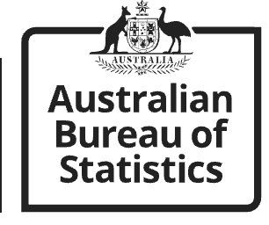
Getting the data we need
Every Australian data science job listing from 2019 to 2022 on Seek.
Australian data science job listing in August 2022 on Glassdoor.
Consumer Price Index (CPI) for every major city in Australia from 2018 to 2022.

Slide 12

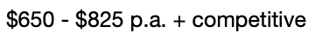
Is the data fit for use?
Major problems found in the job listing dataset.
Data is inconsistent and complex.
61% of salary data is missing.
Salary
Job Title

Slide 13
Data cleaning
Salary
$120000
You will have the following skills/experience - 10yrs+ experience as Data Scientist and Familiar with SQL, R, Python, Tableau, Alteryx
Experience
10
Total Skills
count = 1
Job Type
Data Engineer

Slide 14
Linear Regression Imputation (Salary)
To not weaken the relationship between salary and location.
Job Listing Dataset
City A
City B
City C
Total Skills
Total Skills
Total Skills
Independent
Experience
Experience
Experience
Dependent
Predicted Salary
Predicted Salary
Predicted Salary

Slide 15
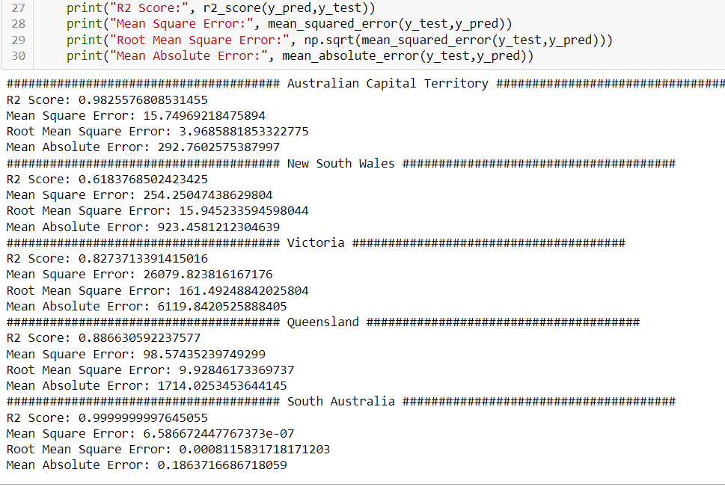
A r2 value close to 1 is considered a good score for the model.
Mean Absolute Error tells about the difference in the predicted and real value

Slide 16
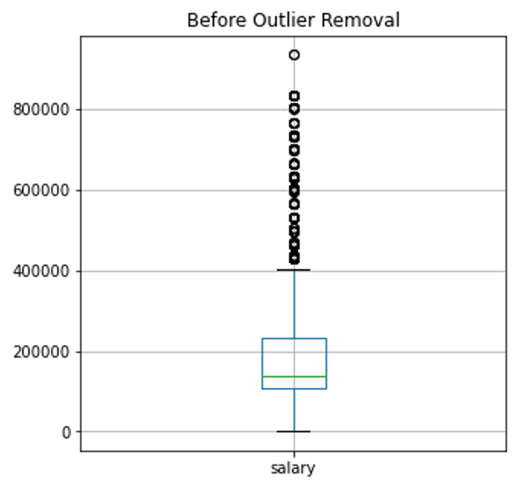
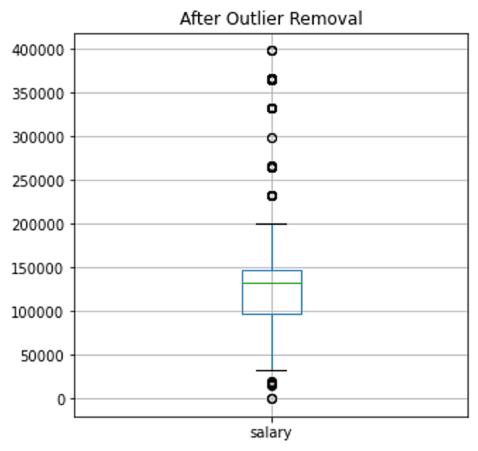
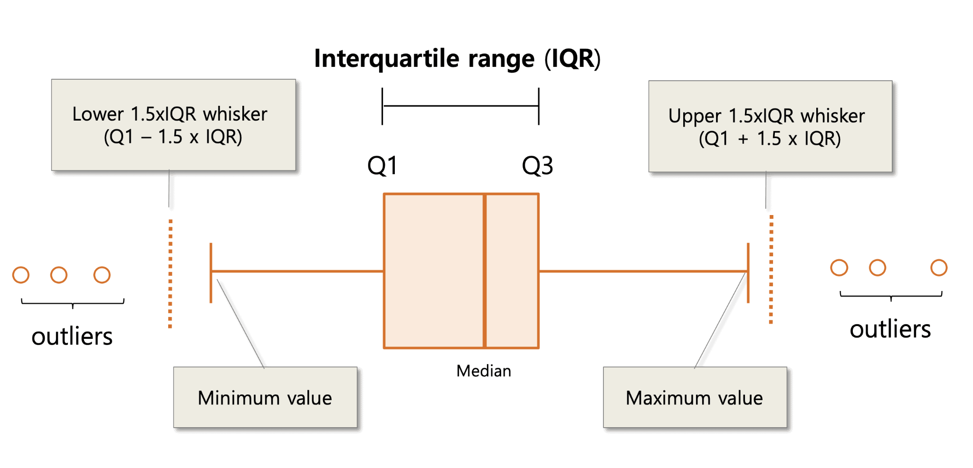
Handling Outliers
For outlier Detection we have assumed that the data is normally distributed. The rule of data falling between the upper and lower limit of box plot is considered, where every value outside of this range is removed from the data set.

Slide 17
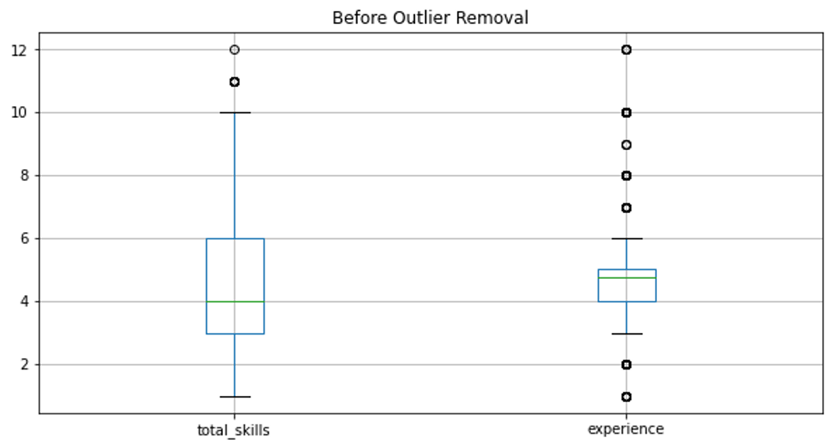
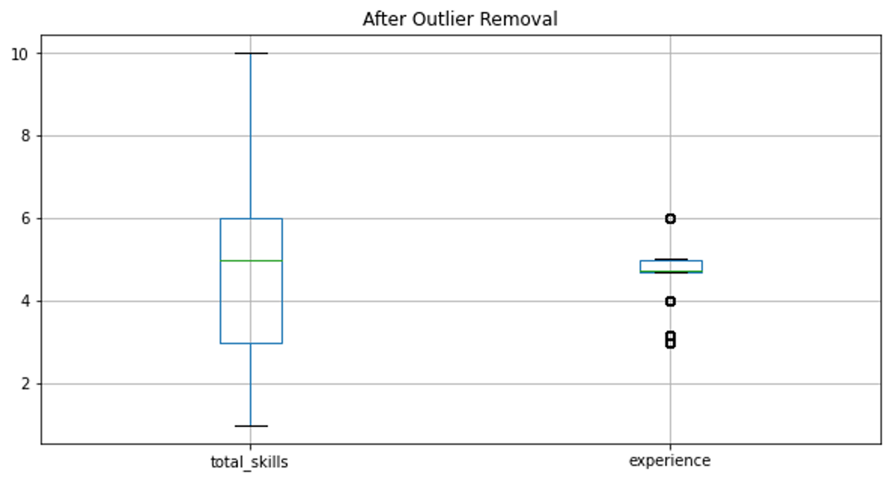

Slide 18
Making the data confess

Slide 19
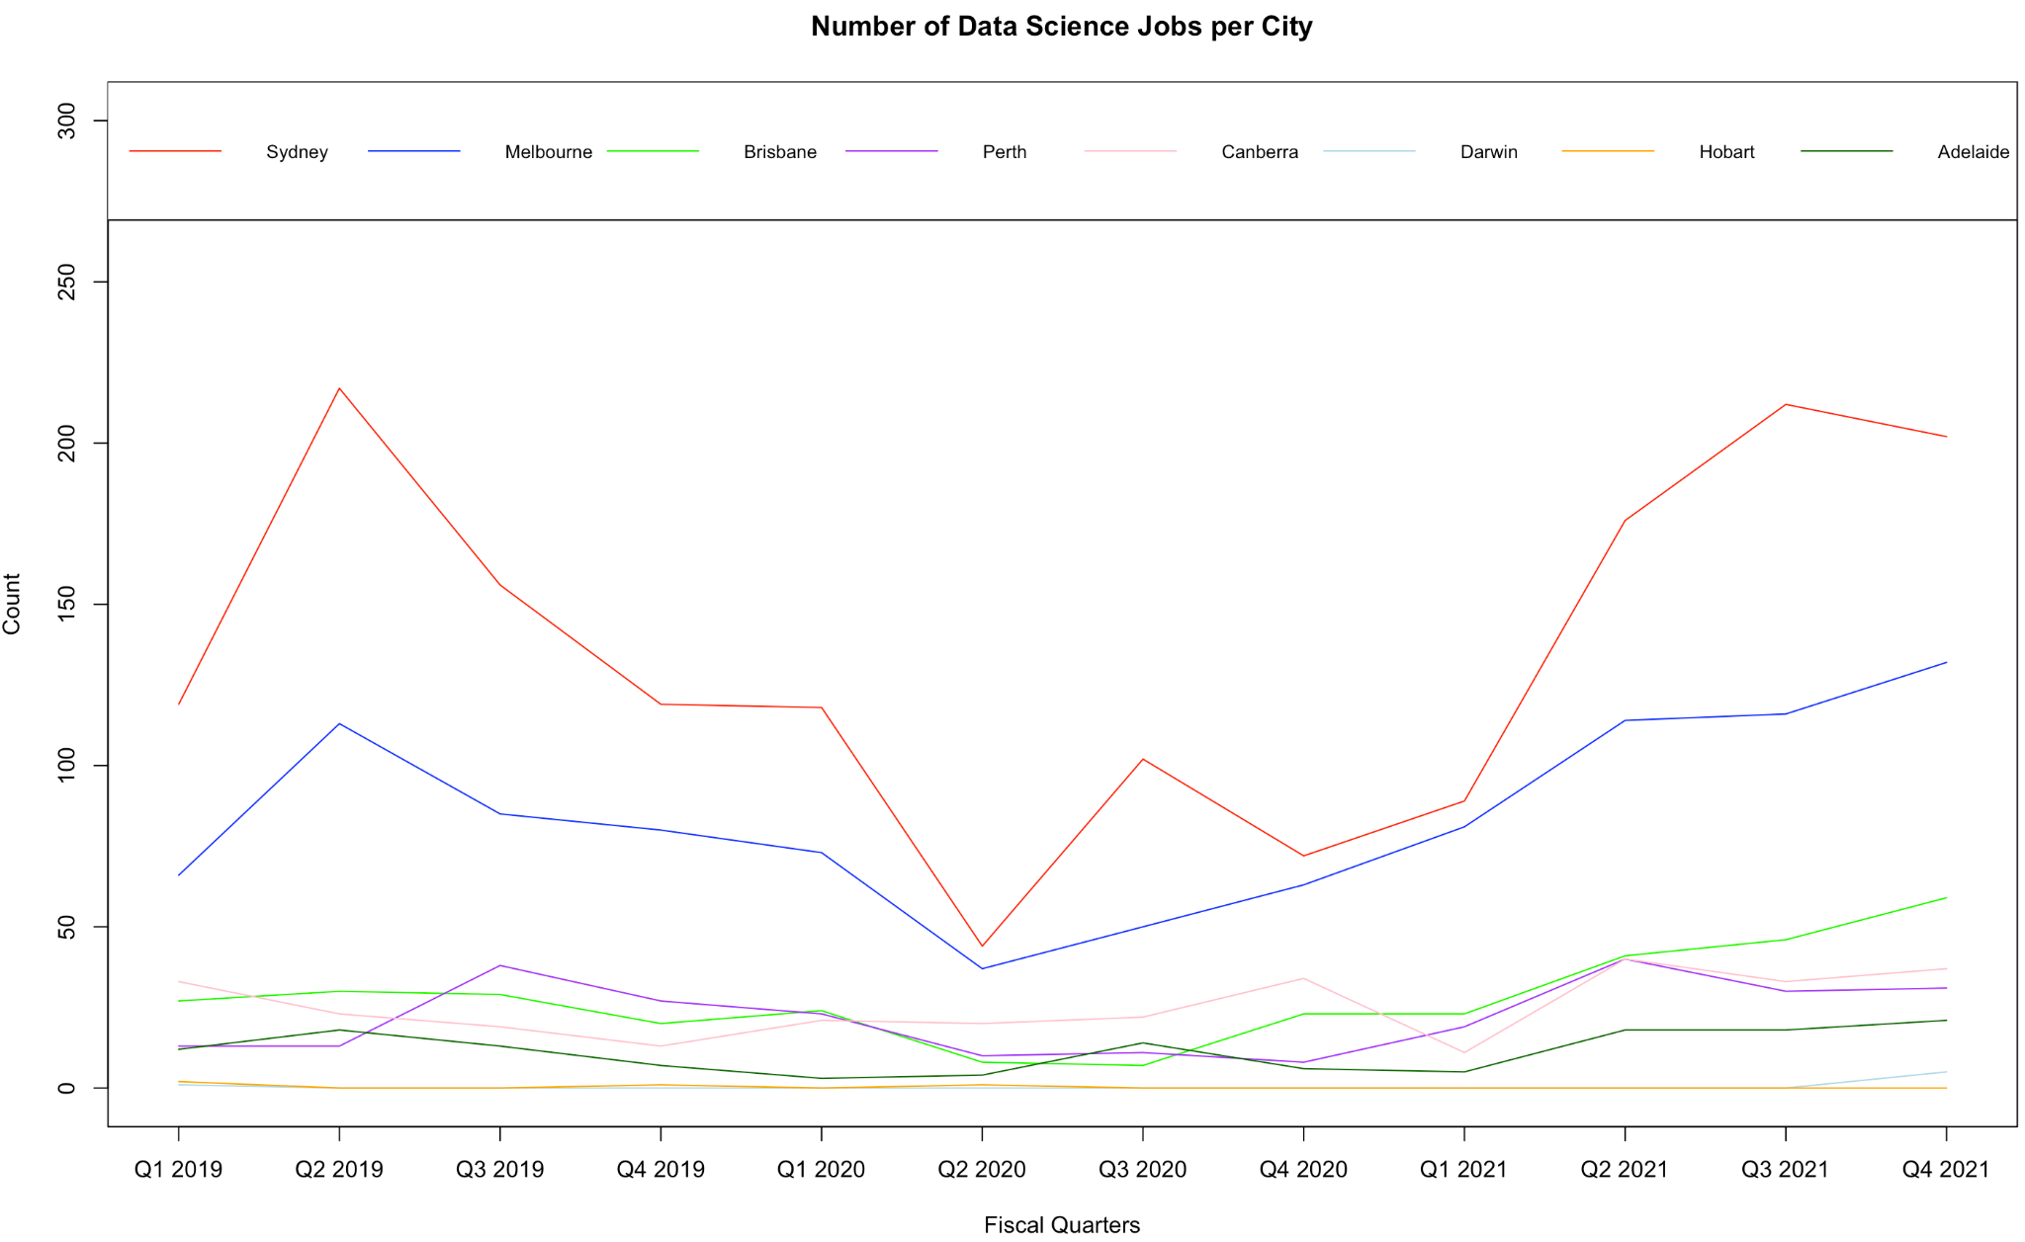
Many job listings were located at Sydney and Melbourne. Both had a noticeable impact during COVID-19.
Ease of COVID restrictions increased number of job listings.

Slide 20
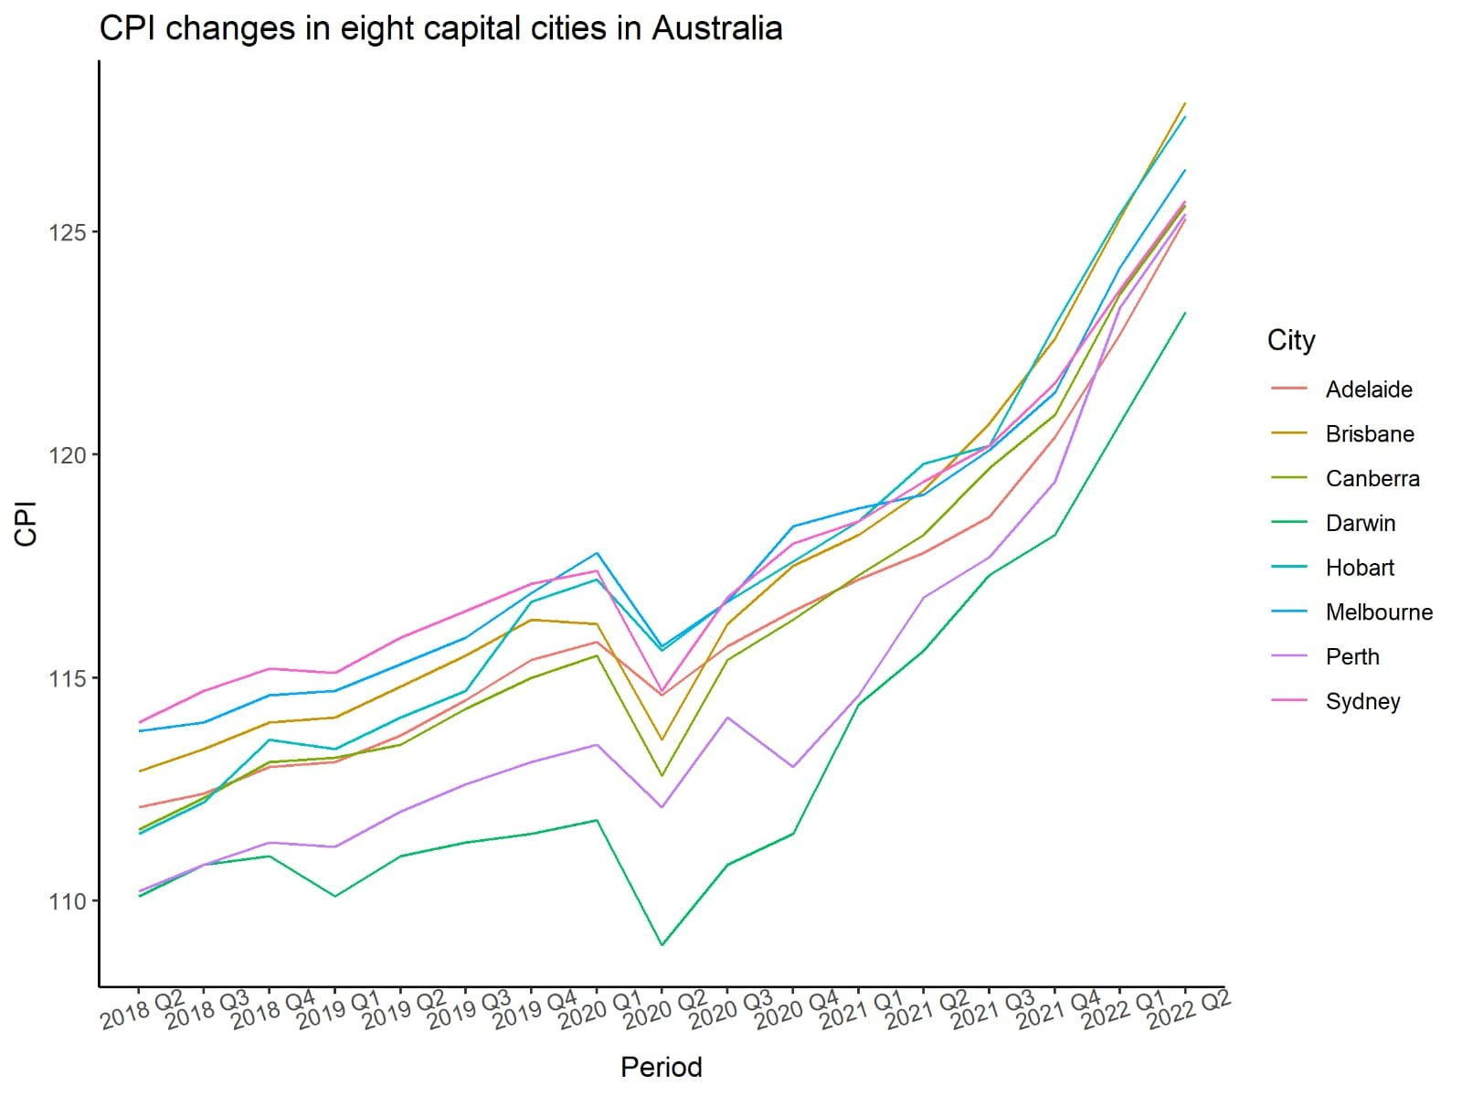
The overall trend of CPI is rising in Australia.
Every city impacted by COVID.
Drop in CPI during COVID-19. International travels, accommodations, and automotive fuel decreased.
Increased rate of growth in 2022 due to rising transport costs, new dwellings, and education.
Darwin has the slowest growth.

Slide 21
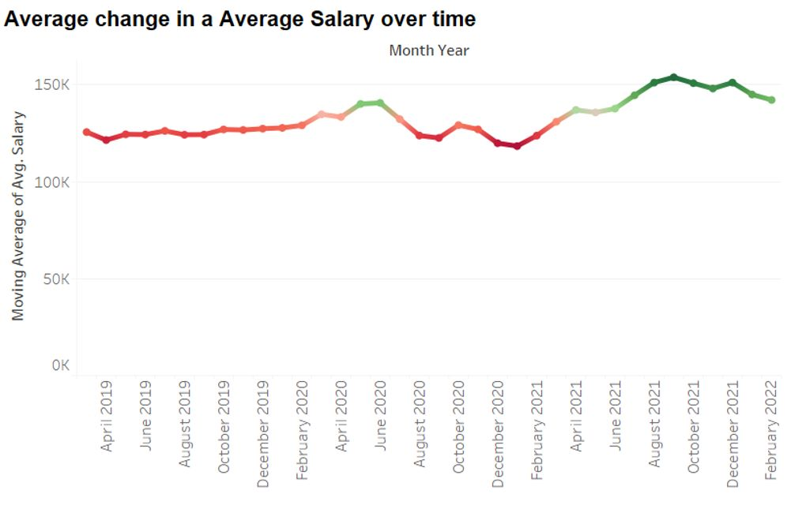
Drop in salary during COVID.
Positive movement, but very slow.
Average salary in Australia is quite impressive (6 figure salary).

Slide 22
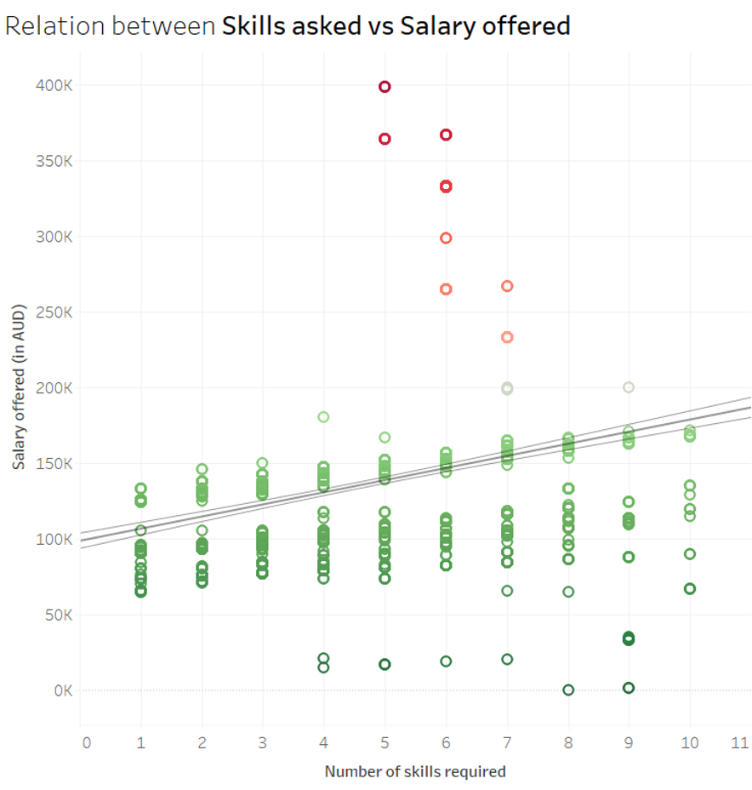
5 skills are typically demanded by employers.
Salary increases as more skills are required.
Likely earn around $100k with only 1 skill.

Slide 23
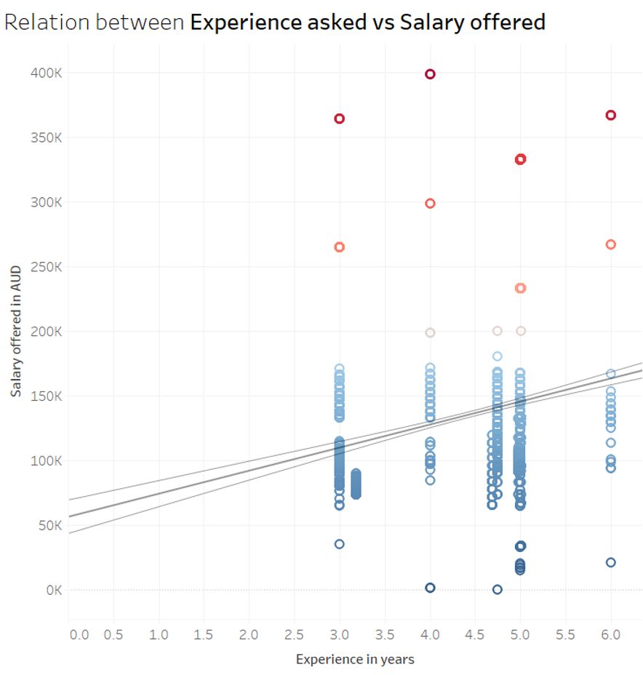
At least 3 years of experience asked by employers.
4 or 5 years of experience is most desirable.
Salary increases as more experience is asked.

Slide 24
Storytelling with data
Notes:
The next part is Storytelling with data.

Slide 25
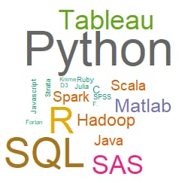
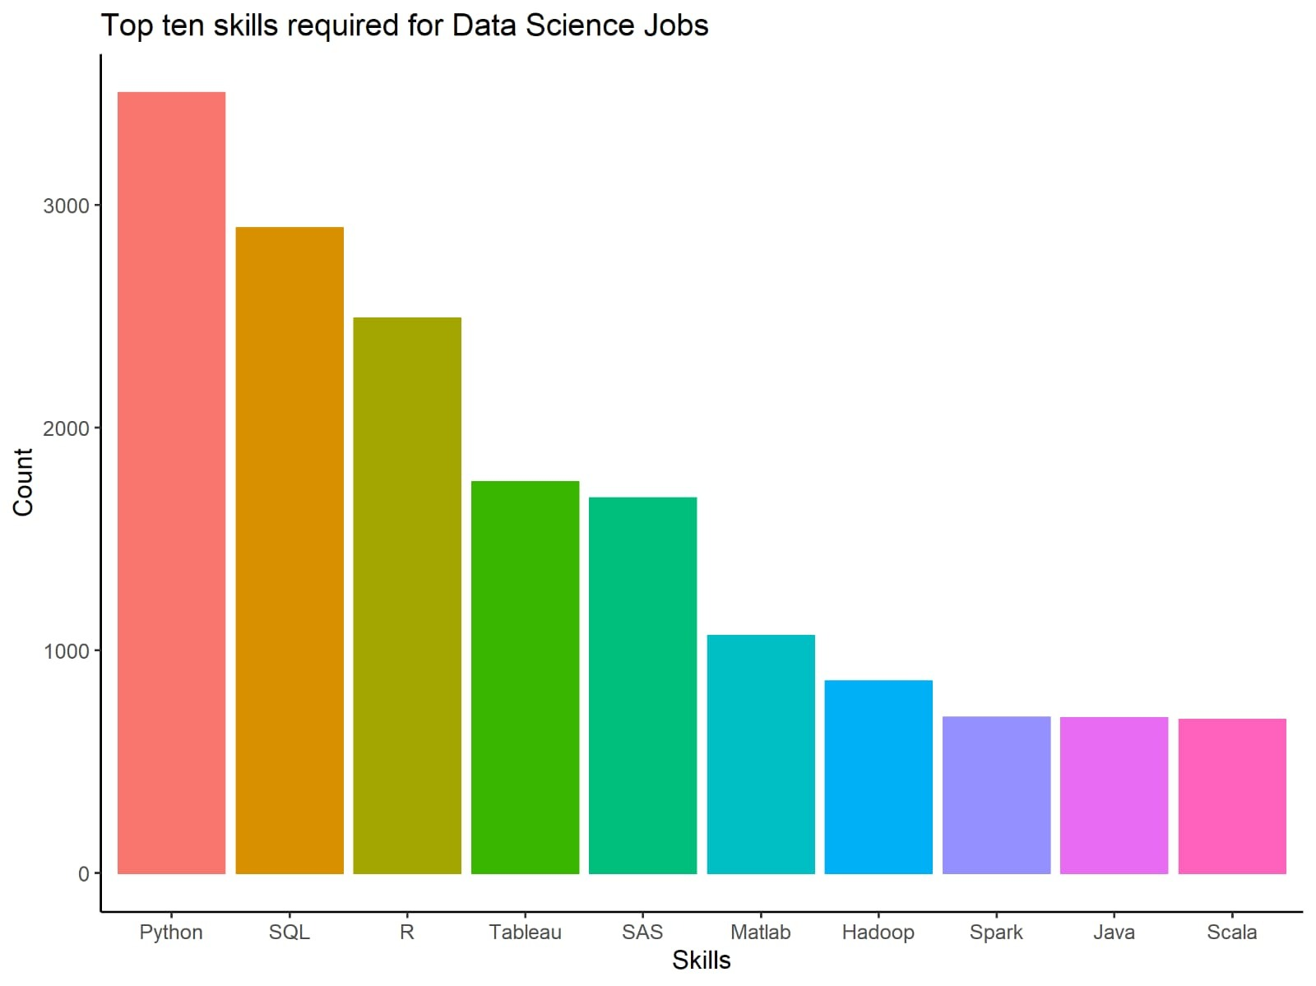
Python and R are the most demanded languages for data analysis.
SQL is a highly demanded complementary skill.
Tableau is the most required software for data visualization.
Notes:
First, we focus on the skills required for data science jobs.
We create a bar plot and a word cloud to show the significance of different skills required for data science jobs. We can see that Python and R are the most demanded languages for data analysis; SQL is a highly demanded complementary skill; while Tableau is the most required software for data visualization.

Slide 26
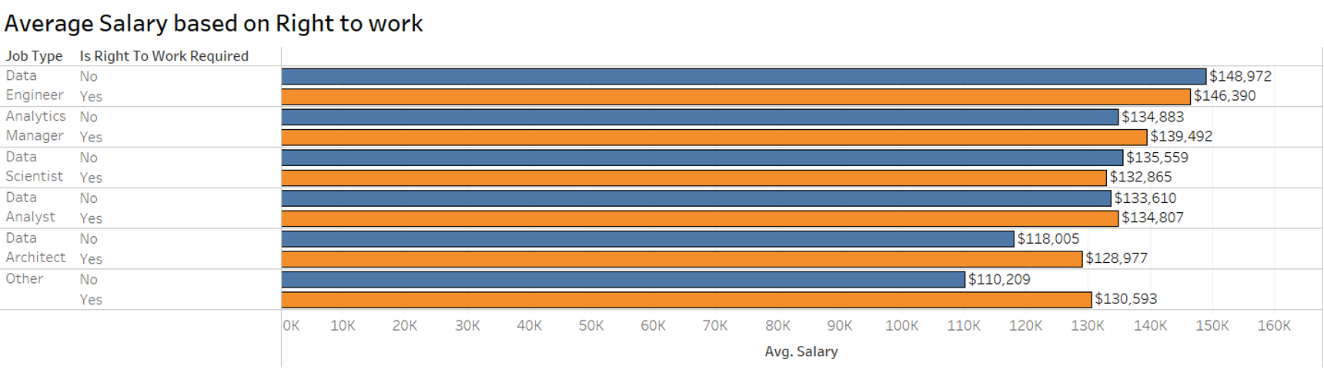
No significant impact of right to work status except for data architects and other unknown titles.
Data Engineer classified as the highest income data science job.
Notes:
Next, we focus on the average salary based on different aspects. The first is the right to work. The bar plot shows that there is no significant impact of the right to work status except for data architects and other unknown titles, and Data Engineer is classified as the highest income data science job.

Slide 27
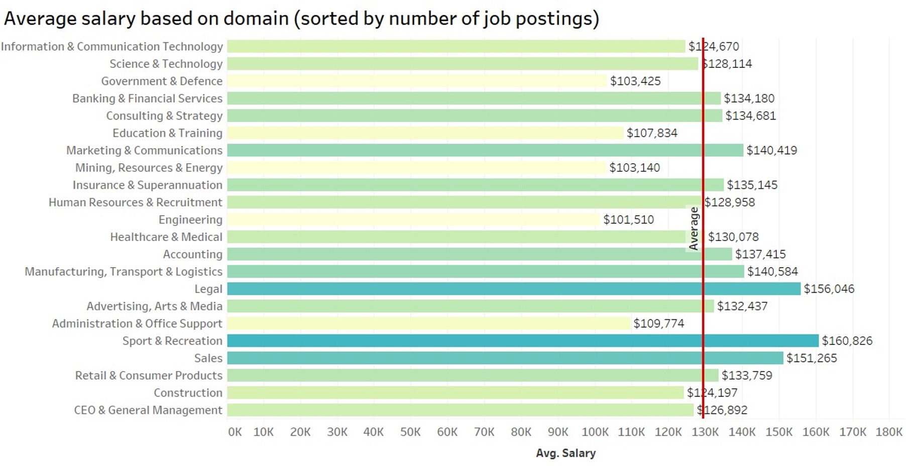
Technology domains pay below average, but most offered.
Legal and Sport & Recreation pays the most, but offered less.
Notes:
The other aspect is the average salary based on domains. The bar plot shows that technology domains have the most job postings, but the salary is slightly below the average. Other domains like Legal, Sport and Recreation have fewer job postings but higher salaries.

Slide 28
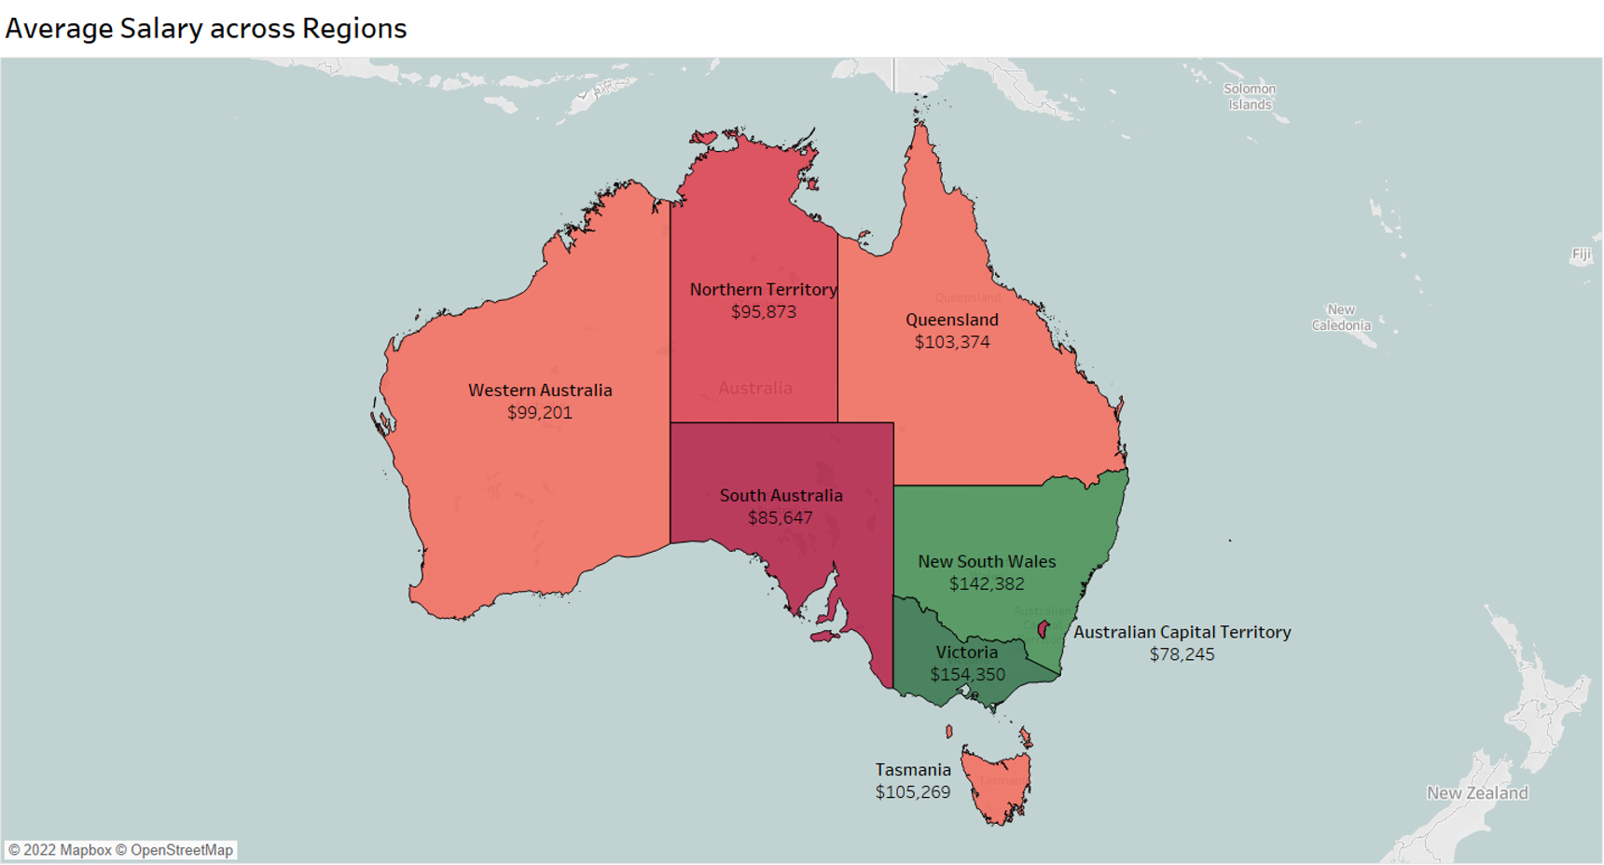
Notes:
Then, we create a heap map to show the average salary in different states in Australia. Victoria took first place, with an average salary of over 154,000 dollars. New South Wales ranked second, with a salary of over 140,000 dollars. While other states like Queensland, Northern Territory, and Western Australia have much lower salaries, South Australia ranked last, with a salary of about 86,000 dollars.

Slide 29
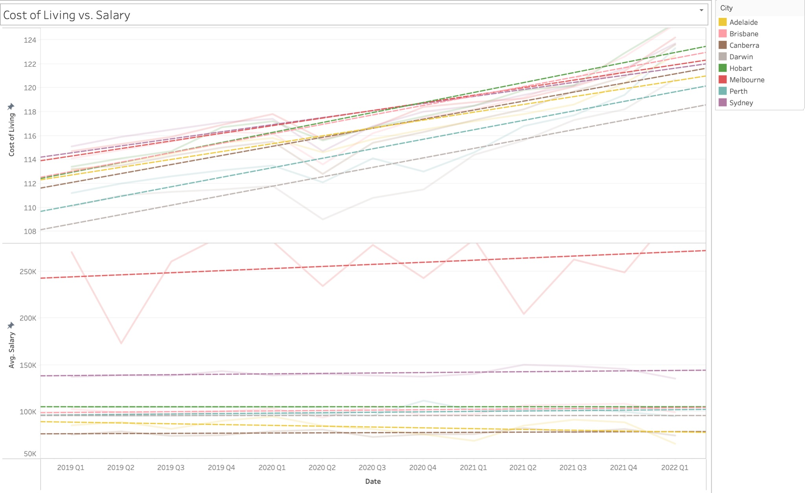
Cost of living increasing rapidly while salary remains quite steady.
Melbourne offers outstandingly high salary.
No decline in salary trend
Notes:
Next we compared the cost of living with average salary of data science jobs. The cost of living increased rapidly from 2019 to 2022, while salary remained quite steady. Melbourne offers outstandingly high salary among other cities. Although there is no significant increase in salary, there is no decline trend either.

Slide 30
Conclusion
Cost of living increases faster than average salary in Australia. Less savings. More expenses.
Melbourne offers the highest average salary.
Sydney offers more data science jobs (more opportunities) with great salary.
Learn Python, R, SQL, and Tableau. Highly recommended.
5 skills and 4 to 5 years of experience commonly desired. Rewarded with higher salary if you have exceeding capabilities!
Highly impacted (negative) by global disasters such as COVID-19.
Notes:
In conclusion, the cost of living increases faster than average salary in Australia, which leads to more expenses and less savings. Melbourne offers the highest average salary, while Sydney offers more data science jobs with high salary as well. The skills most needed for data science jobs include Python, R, SQL and Tableau. In the job market, 5 skills and 4 to 5 years of experience are commonly desired. If you have exceeding capabilities, you may get higher salary in reward. Although data scientist is considered as the sexiest job in the 21st century, it could still be highly impacted by global disasters such as covid-19 pandemic. That’s all of our presentation, thank you!

